Slide 1
Non-Destructive Testing (NDT) Module 1
Rahul Singh Assistant Professor
Department of Mechanical Engineering
1

Slide 2
Introduction to NDT
•
Nondestructive testing or non-destructive testing (NDT) is a wide group of analysis techniques used in science and technology industry to evaluate the properties of a material, component or system without causing damage.The terms nondestructive examination (NDE), nondestructive inspection (NDI), and nondestructive evaluation (NDE) are also commonly used to describe this technology.Because NDT does not permanently alter the article being inspected, it is a highly valuable technique that can save both money and time in product evaluation, troubleshooting, and research

Slide 3
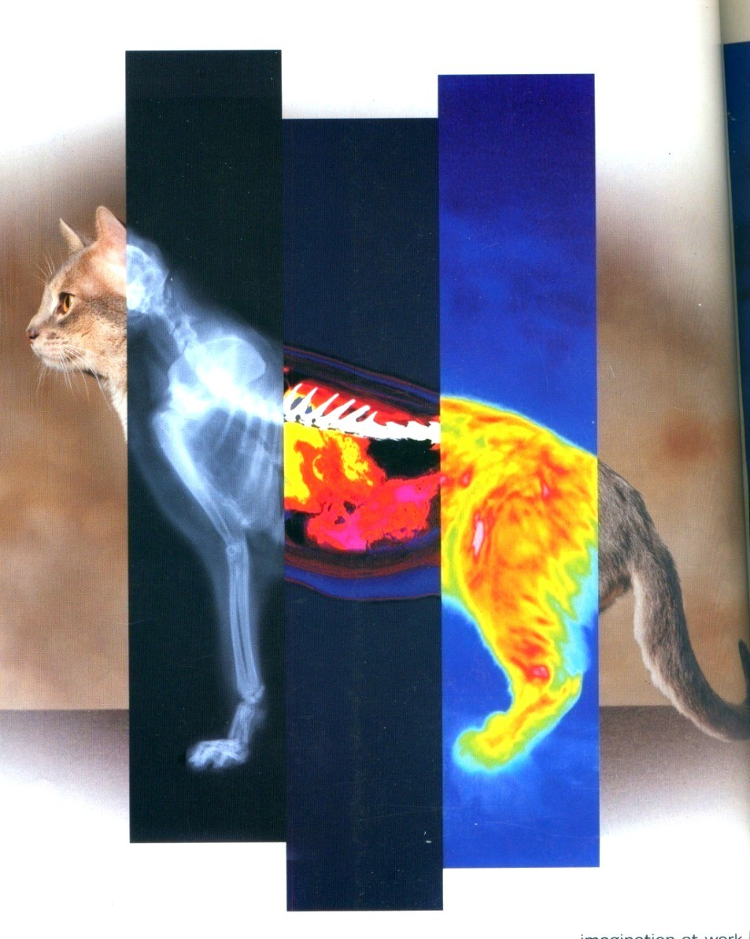
Non-Destructive Testing (NDT)
Non-Destructive testing is the use of noninvasive techniques to determine the integrity of a material, component or structure or quantitatively measure some characteristics of an object. It is
the testing of materials, for
or
surface or internal flaws
metallurgical condition, without interfering in any way with the integrity of the material or its suitability for service.
i.e. Inspect or measure without doing harm.

Slide 4
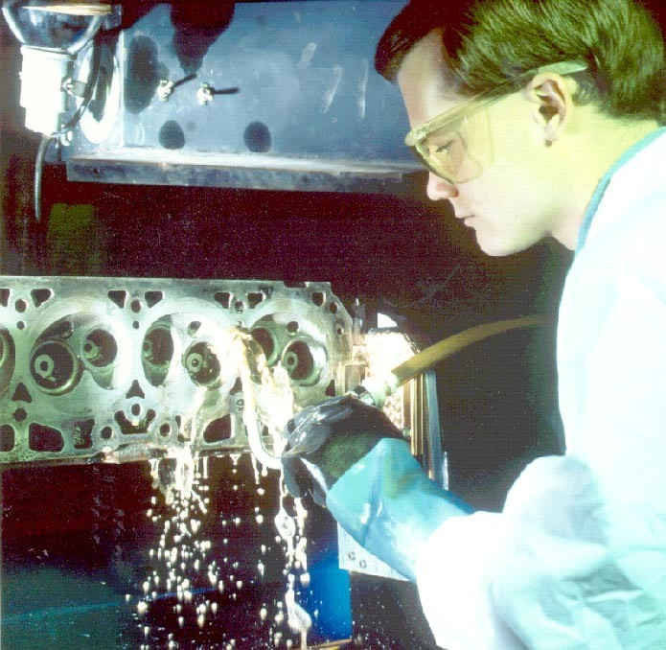
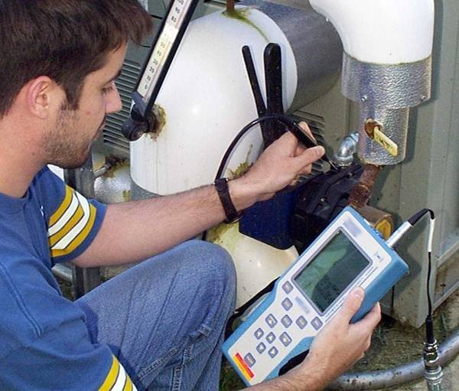
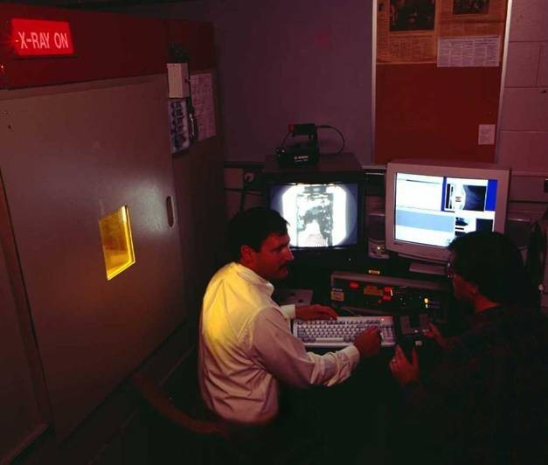
Six Most Common NDT Methods
•
•
•
•
•
•
Visual
Liquid Penetrant Magnetic Ultrasonic
Eddy Current X-ray

Slide 5
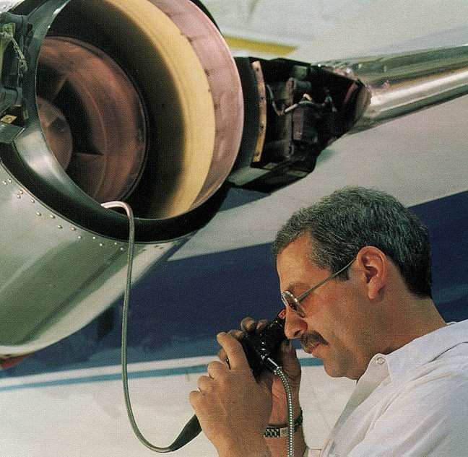
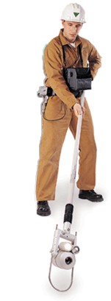
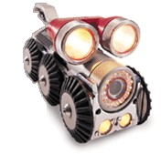
1. Visual Inspection

Slide 6
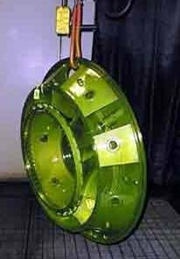
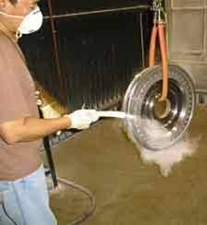
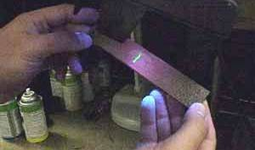
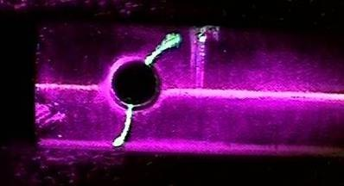
2.Liquid Penetrant Inspection
Downloaded from Ktunotes.in

Slide 7
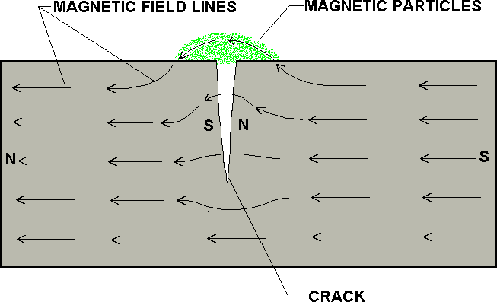
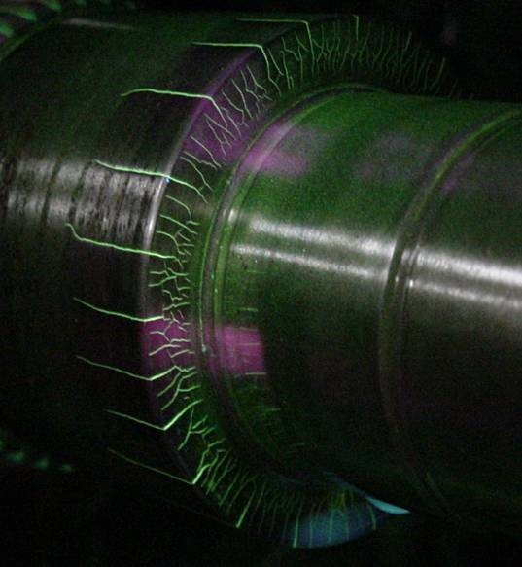
3.Magnetic Particle Inspection

Slide 8
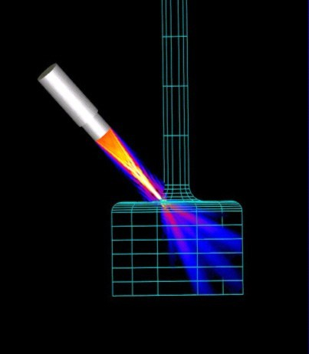
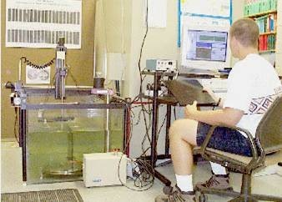
4.Ultrasonic Imaging

Slide 9
5.Eddy Current Testing
Coil's magnetic field
Coil
Eddy current's magnetic field
Eddy currents
Conductive material
Downloaded from Ktunotes.in

Slide 10
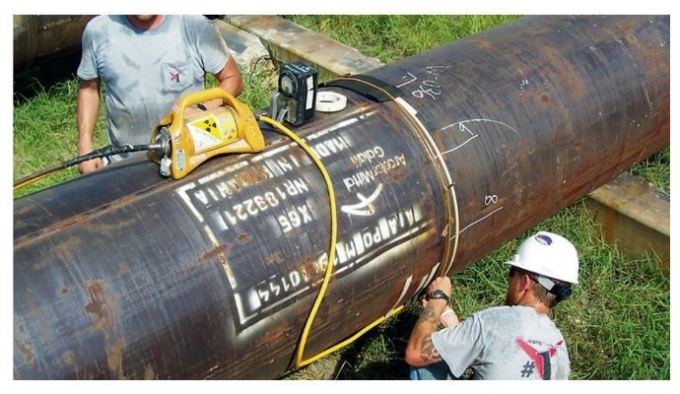
6.Radiograpic Inspection (x-Ray)

Slide 11
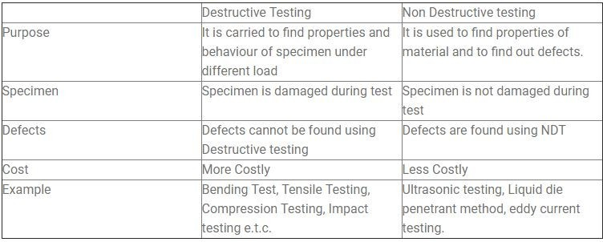
Comparison Between Destructive and Non Destructive Testing

Slide 12
Importance of NDT
NDT increases the safety and reliability of the product during operation.
It decreases the cost of the product by reducing scrap and conserving materials, labor and energy.
It enhances the reputation of the manufacturer as a producer of quality goods. All of the above factors boost the sales of the product which bring more economical benefits for the manufacturer.
NDT is also used widely for routine or periodic determination of quality of the plants and structures during service.
This not only increases the safety of operation but also eliminates any forced shut down of the plants.

Slide 13
Scope of NDT
•
Non-destructive testing is a descriptive term used for the examination of materials and components in such a way that allows materials to be examined without changing or destroying their usefulness. NDT or NDE can be used to find, size and locate surface and subsurface flaws and defects.
NDT plays a crucial role in everyday life and is necessary to assure safety and reliability. Typical examples are found in aircraft, spacecraft (shuttle), motor vehicles, pipelines, bridges, trains, power stations, refineries, buildings and oil platforms which are all inspected using NDT.
•
•
NDT is a Quality Assurance management tool which can give impressive results when used correctly. It requires an understanding of the various methods available, their capabilities and limitations, knowledge of the relevant standards and specifications for performing the tests

Slide 14
Scope of NDT Cont..
NDT is used typically for the following reasons:
Accident prevention and to reduce costs To improve product reliability
To determine acceptance to a given requirement To give information on repair criteria.

Slide 15
Difficulties in NDT
•
However lack of skilled operators, an aging workforce and cost conscious users are key challenge faced by Non Destructive testing market. Though development in infrastructure and power generation have incrementally increased demand for new operators but shortage of supply and shrinking budget continues to …

Slide 16
Future Progress in NDT
3D characterisation
Ultrasound is the ideal vehicle for exploring the local response of a composite structure to stress, and map this across the whole 3D structure
Mechanical Modelling Using NDT Data
Recent developments in X-ray CT and ultrasonic 3D characterisation of composites offer the potential for a greater understanding of the effects on structural integrity of material variations such as in-plane fibre waviness, out-of-plane ply wrinkling, and 3D variations in fibre-volume fraction or porosity

Slide 17
Economic Aspects of NDT
It is highly Economical compared to other methods.
Products can be reused
Rejection rate is less

Slide 18
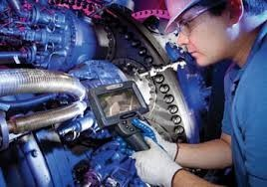
Visual Inspection

Slide 19
Visual Inspection
Most basic and common inspection method.
Portable video inspection unit with zoom allows inspection of large tanks and vessels, railroad tank cars, sewer lines.
Robotic crawlers permit observation in hazardous or tight areas, such as air ducts, reactors, pipelines.

Slide 20
Visual Inspection
Visual Inspection is one of the most widely used Non-Destructive Testing methods for the detection of discontinuities before they cause major problems, e.g. poor welding, surface defects, corrosion pits, general condition, degradation, blockages and foreign materials.

Slide 21
Visual Inspection means the inspection of equipment and structures using a combination of human senses such as vision, hearing, touch and smell.
Visual Inspection is sometimes carried out in conjunction with devices such as a low power magnifying glass, boroscopes, fiberscopes, digital video borescopes, camera systems and robotic crawler systems.

Slide 22
Generally, almost any specimen can be visually examined to determine the accuracy of its fabrication.
For example, visual inspection can be used to determine whether the part was fabricated to the correct size, whether the part is complete, or whether all of the parts have been appropriately incorporated into the device.

Slide 23
Vision
The eye
•Human eye is the most valuable NDT Tool
•Sensitivity of the human eye varies according to the light source
•Human eye has an excellent visual perception
•Yellow green light of wavelength 5560°A is the most suitable light for human eye at normal condition

Slide 24
Tools Used in Visual Inspection
Mirrors
Magnifying Glasses
Microscopes
Borescope
Endoscope
Flexible fibres
Closed circuit Television system
Computer enhanced systems

Slide 25
Applications of Visual Inspection
It is used to inspect whether there is a misalignment of parts in the equipment
It checks for corrosion, erosion, cracks and deformities of machine components
It inspect the plant components for any leakage or abnormal operation
It is used to identify the defects in weldments

Slide 26
Limitations of Visual Inspections
Can identify only large discontinuities
Limited to surface discontinuities
Skilled labour required
Result depend on the eye resolution of the inspector
It may cause eye fatigue to the inspector

Slide 27
Lighting and Lighting source
The amount of light is depend up on the type of test.
For an appropriate visual inspection, suitable lighting of about 800-1000 Lux
The major lighting sources are
Incandescent Lamp
Fluorescent lamp
High intensity discharge lamp

Slide 28
Material factors that affect Visual Testing
Surface Condition
Cleanliness
Colour
Texture
Physical Conditions
Specimen Condition
Shape and Size
Temperature
Environmental Factors
Atmosphere
Cleanliness
Humidity and Temperature
Safety
Physiological Factors
Physical Comfort
Health , mental attitude, fatigue and test item position

Slide 29
Types of Visual Inspection
1. Unaided Visual Inspection
2.Aided Visual Inspection

Slide 30
1. Unaided Visual Inspection
It is also Known as Direct Visual Inspection
It can be accomplished with the help of naked eye
It can done with out the help of optical aids
Defects can be detected are
– Absence of cracks, Corrosion layer, surface porosity, Misalignment of mated parts

Slide 31
2. Aided Visual Inspection
It is also known as Indirect Visual Inspection
It is performed using optical instruments
This will identify the defects which cannot detect with human eye
It permits visibility to areas are not accessible to human eye

Slide 32
Visual Perception
It is the interpretation of impressions transmitted from retina of eye to the brain in terms of information
Visual perception depends on the vision acuity
Human eye has an excellent visual perception

Slide 33
Tools Used in Visual Inspection
Mirrors
Magnifying Glasses
Microscopes
Borescope
Endoscope
Flexible fibres
Closed circuit Television system
Computer enhanced systems

Slide 34
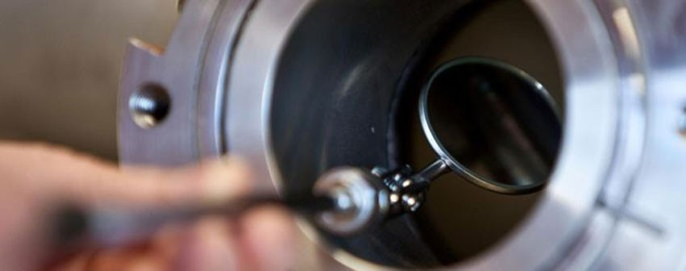
Magnifying Mirrors
It is also known as concave spherical mirrors
It is used to magnify the areas which are not accessible to human eye.

Slide 35
Magnifying Glass
It is also called as Hand Lens
This lens is used to produce a magnified Image
Magnification depends upon the position where it is being placed between the human eye and the object
For higher power magnification, double or multiple lenses are used

Slide 36
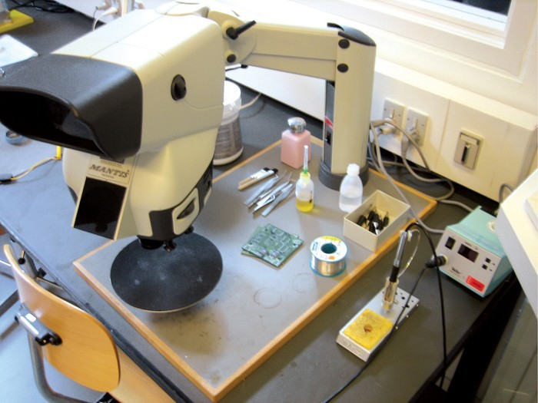
Microscope
Microscope is used to magnify the image of a small object
Magnification Power = 10/F

Slide 37
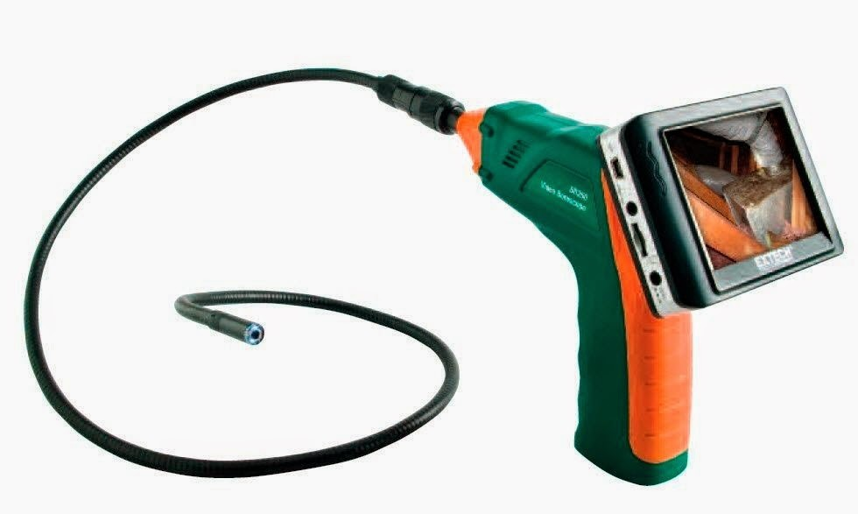
Borescope
Which is used to inspect the inside of a narrow tube
It is a flexible tube with an eyepiece at one end and objective lens at another end
Light is passed through the lens and to obtain a clear image
Available range is 2.5 mm to 19 mm
Video

Slide 38
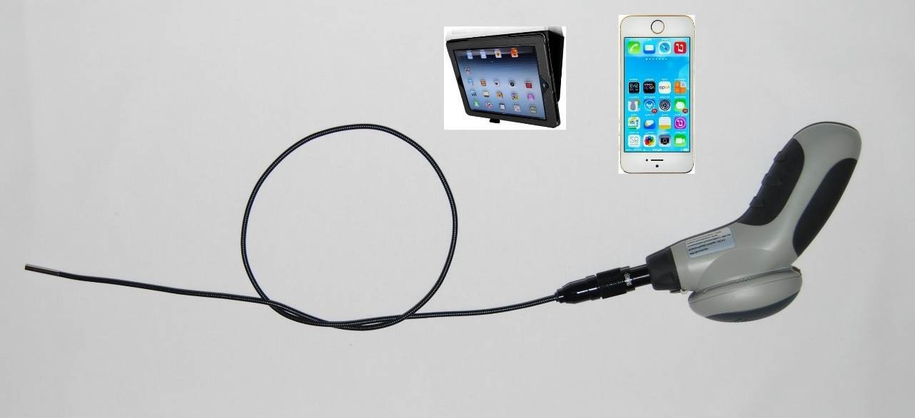
Endoscope
It is bit superior than borescope
Magnification factor of 10X is obtained
Available up to smaller dia of 1.7 mm and length upto 100-150mm

Slide 39
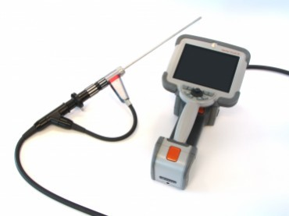
Fibroscopes
Also called fibre optic borescope
Dia range of about 3 to
12.5mm and length varies between 60 – 365 cm

Slide 40
Special Lighting
Back Lighting
Front Lighting
Structured Lighting
Strobe Lighting
Ultraviolet Lighting

Slide 41
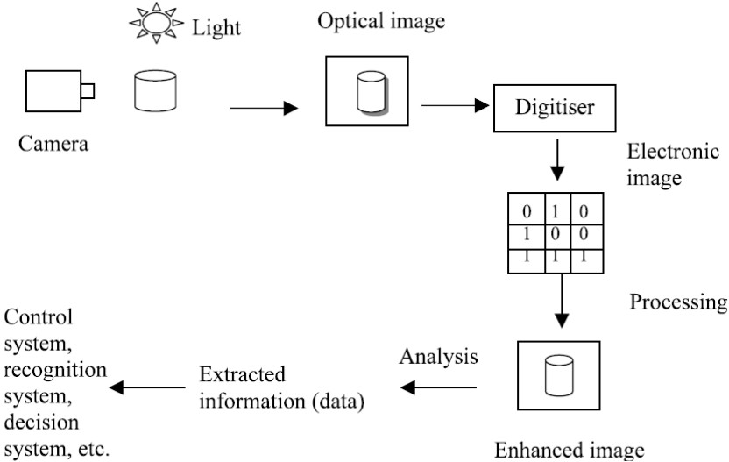
Computer Enhanced Visual System

